Slide 1
Diabetes Prediction SYSTEM using Machine Learning Techniques

Slide 2
ABSTRACT
Diabetes is considered as one of the deadliest and chronic diseases which causes an increase in blood sugar. Many complications occur if diabetes remains untreated and unidentified. The tedious identifying process results in visiting of a patient to a diagnostic centre and consulting doctor.
It includes analyzing of data and predicting diabetes using attributes like Gender, Creatinine ratio, Cholesterol , Glucose , BMI etc.
In this project we will do prediction of Diabetes in a human body or a patient for a higher accuracy through applying, Various Machine Learning Techniques.
The project is processed using Python, Spark, MongoDB, Machine Learning, Power BI, Flask.

Slide 3
Technologies and Implementation
Extracting and Loading the data
dataworld.com open data source
data is fetched from site using pyspark and stored in MongoDB.
Processing data
Data is processed using pyspark
EDA and ML
EDA is performed in PowerBI
models were applied in Python

Slide 4
METHODOLOGY
Data Used
The data used in this project was of open source Diabetes data of 10MB size.
The data was retrieved using Pyspark. The data was in CSV format.
Data Cleaning
Data cleansing or data cleaning is the process of detecting and correcting (or removing) corrupt or inaccurate records from record set ,tables or database and refers to identifying incomplete, incorrect, inaccurate or irrelevant parts of the data and then replacing, modifying, or deleting the dirty or coarse data.

Slide 5
METHODOLOGY
Data Dumping
Data was dumped into Mongodb using pyspark.
Analysis
The refined data is used to perform predictive analysis and draw appropriate conclusions from the performed data analysis.
Models and Algorithms
Based on the data appropriate machine learning where applied.

Slide 6
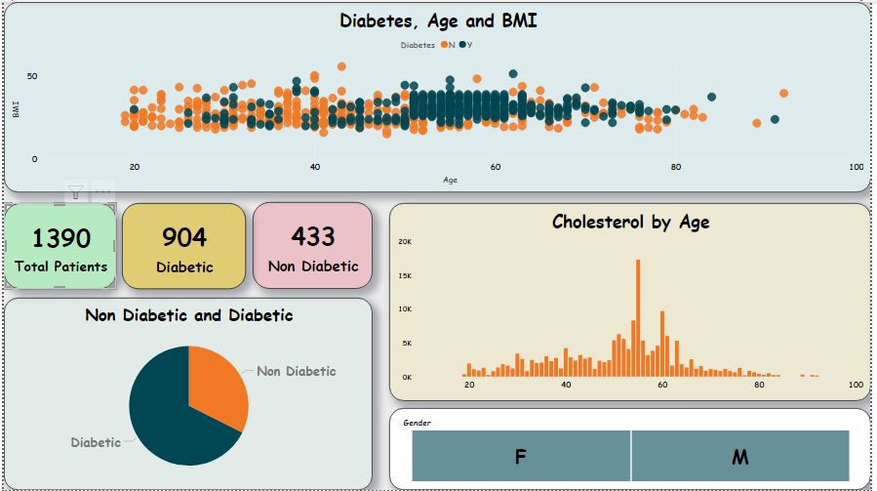
Exploratory Data Analysis

Slide 7
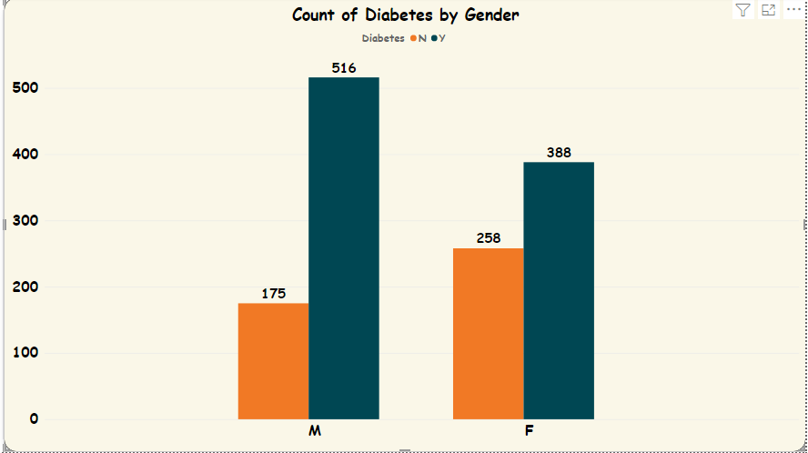
Column Chart

Slide 8
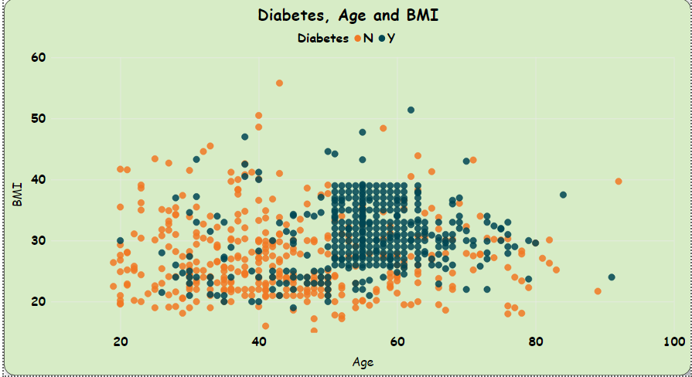
Scatter Plot

Slide 9
ALGORITHMS
Random Forest
K-Nearest Neighbor
Gradient Boosting
XGBoost Classifier
Logistics regression
Support Vector Machine
Decision Tree Algorithm

Slide 10
Models and Findings
Columns Used:
Cholesterol
Glucose
BMI
Age
Gender
HDL
Cholesterol/HDL ratio
Diabetes - (dependent Variable)

Slide 11
Logistic regression
Logistic regression supervised learning technique from the field of statistics borrowed by machine learning which a predictive analysis.
It is a classification algorithm which means the output it provides is discrete (0/1, true/false, yes/no). Logistic regression (LR) is used to describe the relationship between one dichotomous dependent attribute (Y) and one or more nominal independent variables (X).
The dependent variable constitutes the target class or the labelled class we want to predict and the independent variable are the parameters or the variables, which we use to do prediction. Mathematically LR classifier will use the logistic function to do the prediction.

Slide 12
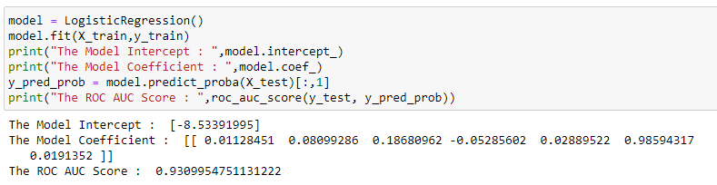
Logistic Regression

Slide 13
KNN
KNN algorithm is a supervised machine learning algorithm that deals with similarity. KNN stands for K-Nearest Neighbors. It’s basically a classification algorithm that will make a prediction of a class of a target variable based on a defined number of nearest neighbors. It will calculate distance from the instance you want to classify to every instance of the training dataset, and then classify your instance based on the majority classes of k nearest instances.

Slide 14
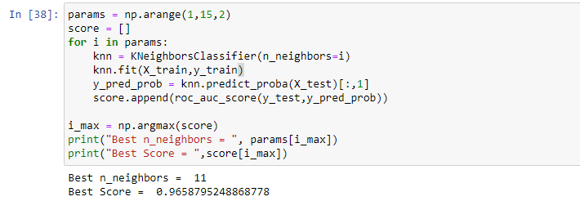
KNN

Slide 15
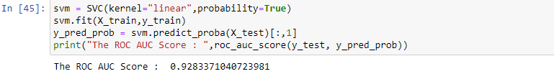
Support Vector Machine
Support Vector Machine is a supervised learning model employed to deal with classification and
regression, mainly focusing on two-category issues. The aim of this algorithm is to determine the
most appropriate decision boundary that can classify instances into two categories clearly

Slide 16
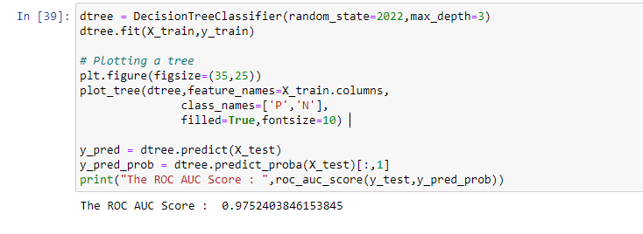
Decision Tree Classifier
Decision Trees (DTs) are a non-parametric supervised learning method used for classification and regression. The goal is to create a model that predicts the value of a target variable by learning simple decision rules inferred from the data features. A tree can be seen as a piecewise constant approximation.

Slide 17
Random Forest
The random forest method is a flexible, fast, and simple machine learning algorithm which is a combination of tree predictors. Random forest produces satisfactory results most of the time.
Random forest builds multiple decision trees and aggregates them to achieve more suitable and accurate results. It has been used for both classification and regression. Classification is a major task of machine learning. It has the same hyper parameters as the decision tree or bagging classifier.
The fact behind random forest is the overlapping of random trees, and it can be analysed easily.
In random forest, a random subset of attributes gives more accurate results on large datasets, and more random trees can be generated by fixing a random threshold for all attributes, instead of finding the most accurate threshold. This algorithm also solves the overfitting issue.

Slide 18
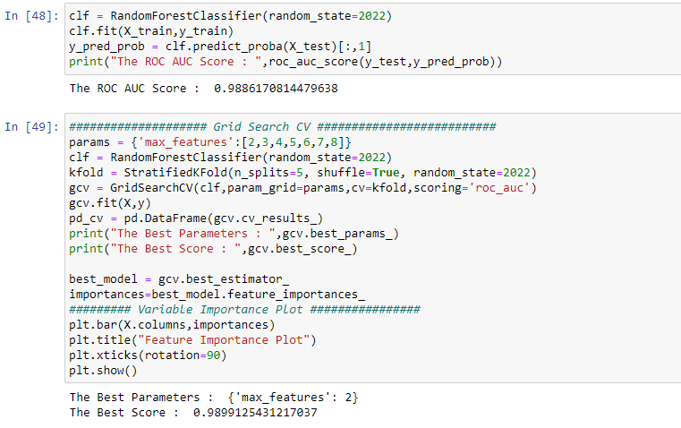
Random Forest

Slide 19
Gradient Boosting
Gradient Boosting algorithm is a supervised learning technique (machine learning) based on gradient descent method.
It can be used for classification as well as regression.
It has ability to reduce variance and bias, and helps weak learner to become stronger.
This model improves prediction accuracy by adding additional trees to correct mistakes made by previous base models.

Slide 20
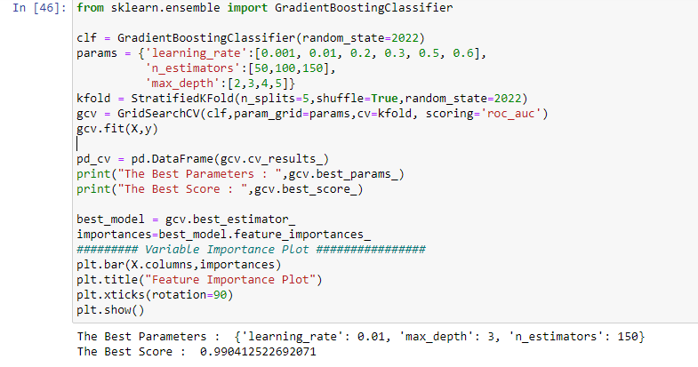
Gradient boosting

Slide 21
XGBClassifier Algorithm
XGBoost, which stands for Extreme Gradient Boosting, is a scalable, distributed gradient-boosted decision tree (GBDT) machine learning library. It provides parallel tree boosting and is the leading machine learning library for regression, classification, and ranking problems.
It’s vital to an understanding of XGBoost to first grasp the machine learning concepts and algorithms that XGBoost builds upon: supervised machine learning, decision trees, ensemble learning, and gradient boosting.
XGBoost has been integrated with a wide variety of other tools and packages such as scikit-learn for Python enthusiasts and caret for R users. In addition, XGBoost is integrated with distributed processing frameworks like Apache Spark and Dask.

Slide 22
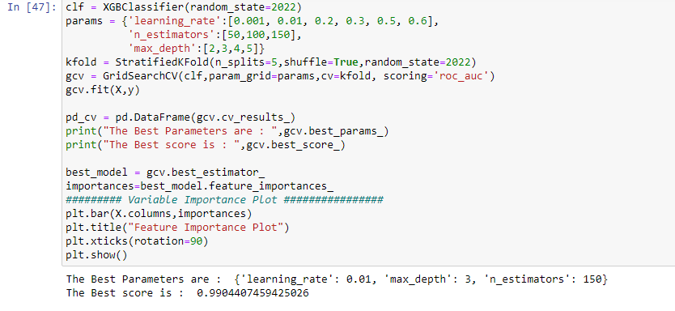
XGBClassifier Algorithm

Slide 23
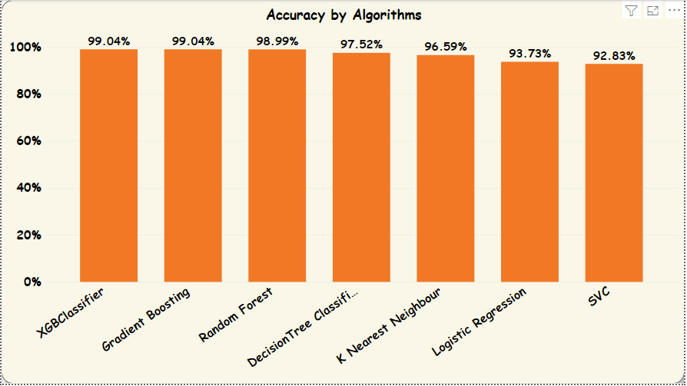
Accuracy of the Algorithms

Slide 24
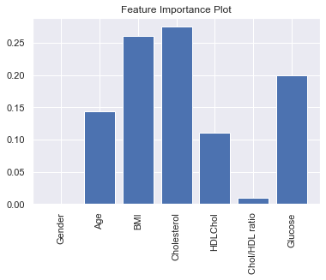
Feature Importance Plot

Slide 25
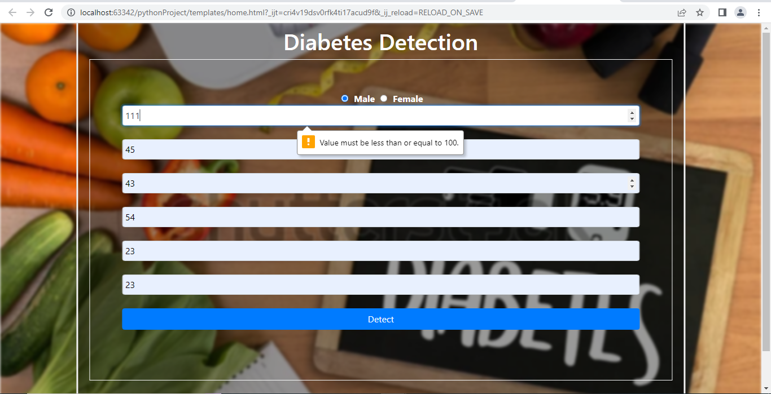
User Interface

Slide 26
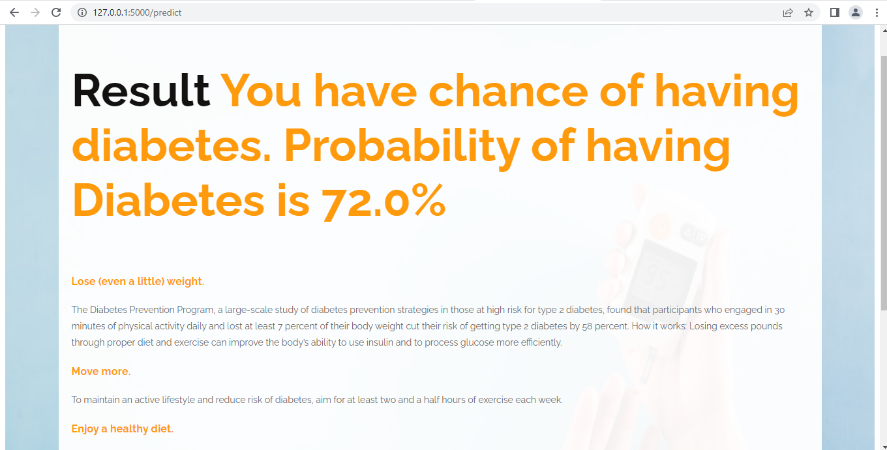
Result

Slide 27
SYSTEM REQUIREMENTS
Hardware Requirements
Platform – Windows, Ubuntu
RAM – At least 8 GB of RAM
Peripheral Devices – Mouse, Keyboard
A network connection for data recovering over network.
Software Requirements
Apache Spark
MongoDB
Python
Machine Learning

Slide 28
Conclusion
After using all these patient records, we are able to build a machine learning model (XGBoost – best one) to accurately predict whether or not the patients in the dataset have diabetes or not along with that we were able to draw some insights from the data via data analysis and visualization.

